Slide 1

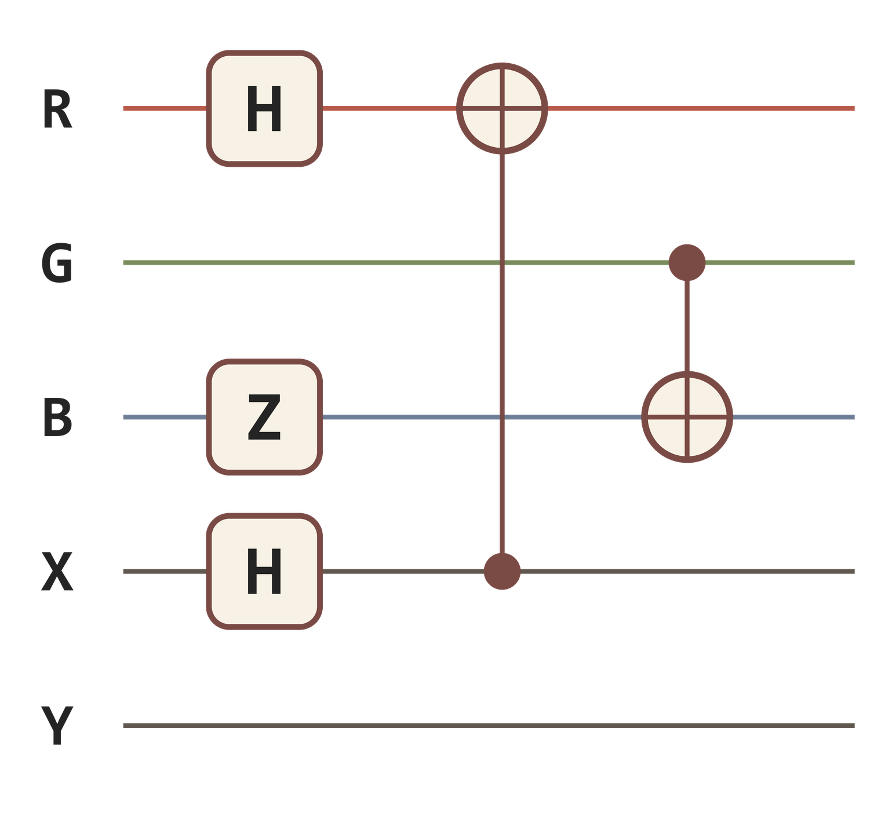
quantimg
QUANTUM HACKATHON · [TEAM NAME]
A drag-and-drop photo filter app where every effect is a quantum circuit.
[Your name] · [Teammate's name]
Notes:
Open with the one-line pitch: we built a photo editor where the filters are quantum circuits. Drag gates onto wires and watch your photo change. Keep the whole talk to about five minutes.

Slide 2

The bridge
The prompt: build a tool that connects a problem in a non-quantum field to a quantum algorithm or application.
NON-QUANTUM FIELD
QUANTUM
Digital art and photo editing
Circuits of gates on qubits
Filters, color grading, glitch art and tileable patterns.
Superposition, interference and entanglement shape every pixel.
Notes:
The prompt asks for a bridge between a non-quantum field and quantum computing. Ours goes from photo editing — something everyone understands — to quantum circuits.

Slide 3
Quantum gates are abstract. Photos make them visible.
Drop a gate on a wire and see what it does to an image you already know.
Notes:
Most quantum tools show probability bar charts. Ours shows the effect of every gate on a picture, so people who have never seen a circuit can build intuition by playing.

Slide 4
One pixel's trip through the circuit
01
02
03
04
Normalize
Tilt and twist
User's gates
Read out
Color and position become numbers from 0 to 1.
RY sets what measurement sees. RZ hides extra information in phase.
Whatever was dragged onto the wires runs here.
The chance each color qubit measures 1, times 255, is the new color.
Red 200 + CNOT from X (x = 0.25) → Red ≈ 164
Notes:
The same small circuit runs on every pixel, like a shader, so the image keeps its full resolution. In the example, the CNOT flips red whenever the X qubit is 1, which happens 25% of the time, so red drops from 200 to about 164.

Slide 5
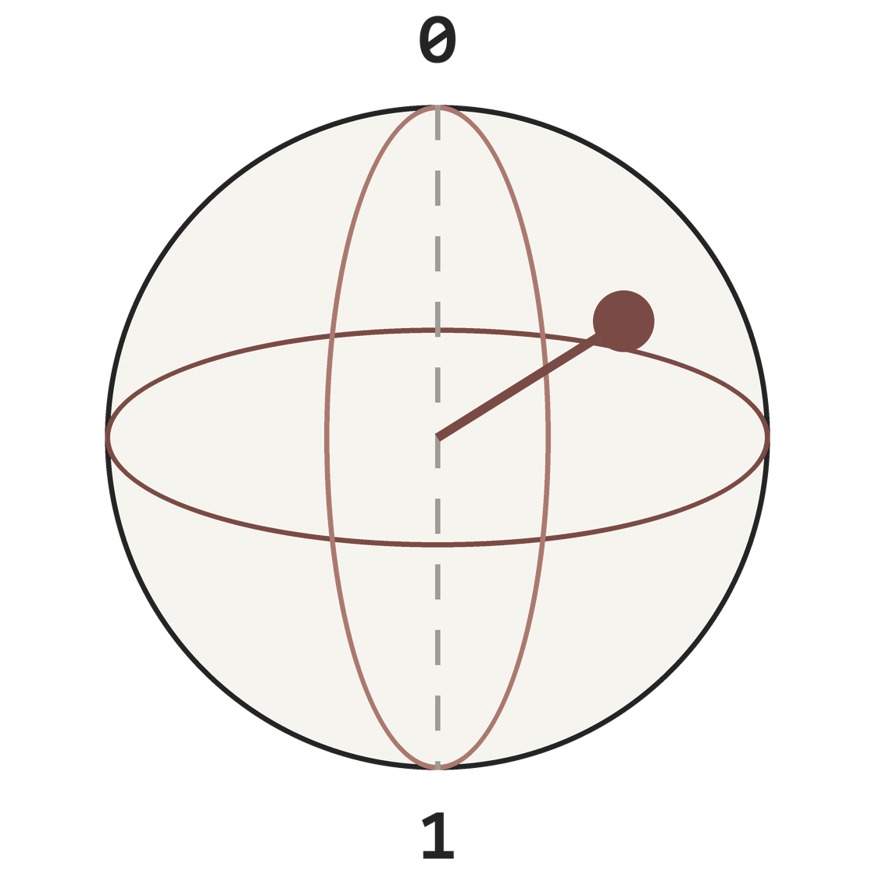
Hiding information in phase
Latitude is the tilt
It sets the chance of measuring 1, so it becomes the color you see.
Longitude is the phase
Measurement ignores it, so position or hue hidden here changes nothing at first.
An H gate reveals it
Hidden phase turns into visible ripples and bands through interference.
Notes:
This is the most quantum part of the tool. We tilt each qubit with RY using the color value, then twist it with RZ using something like the x position. The twist is invisible until an H gate converts phase differences into visible differences — that's interference, and it has no counterpart in ordinary photo editing.

Slide 6
What the filters can do
Interference ripples
Position patterns
Color crosstalk
Hidden phase plus H gates make waves and plasma-like bands.
X and Y controls make stripes, grids and tileable textures.
CNOTs and SWAPs between R, G and B remap colors.
Entangled grain
Quantum convolution
[Demo outputs]
Measured mode makes noise whose channels move together.
A 2×2 window of neighbors interferes into edges and glows.
Replace these cards with before/after images from the tool.
Notes:
Each card is a family of effects users get by combining gates. Before presenting, swap in real before/after images generated by the tool — they'll do more than any description. Quantum convolution is based on the "quanvolution" idea from Henderson et al., 2019.

Slide 7
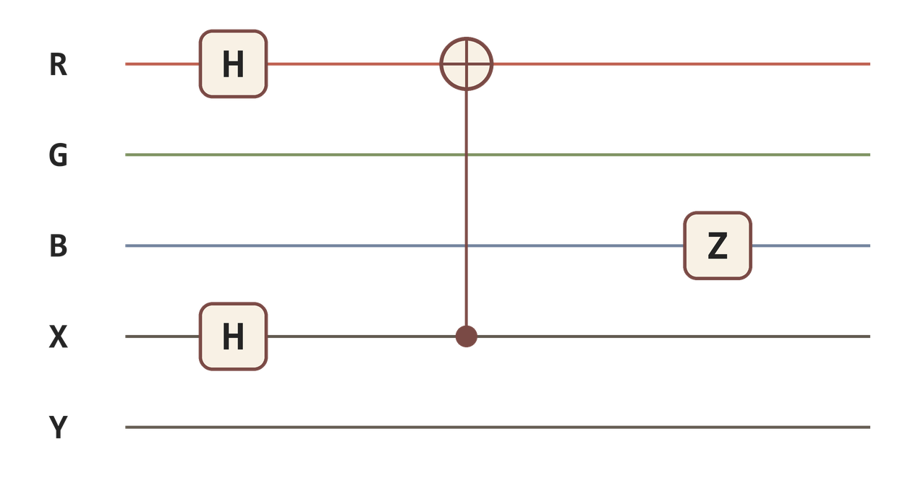
The interface
GATES
CIRCUIT
BEFORE / AFTER
X
Y
Z
H
RY
●
Exact / measured toggle and a shots slider for grain
Wires are labeled by meaning, a control dot makes any gate conditional, and a "show circuit as code" button exports to Qiskit.
Notes:
[Teammate's name] designed the interface. Three panels: a gate palette, the circuit with five meaningful wires, and a live before/after preview. Replace this sketch with a real screenshot once the front end is built.

Slide 8
Where quantum fits
WHAT IT ISN'T
WHAT IT IS
A faster filter
Quantum behavior made visible
There's no speedup. A classical computer could reproduce any single effect, and it simulates ours anyway.
Interference and entanglement drive effects with no ordinary slider equivalent, and anyone can learn gates by playing.
Notes:
Be upfront: the value is creative and educational, not computational. Judges at quantum events tend to respect clear thinking about where quantum helps more than overstated claims.

Slide 9
Drag a gate. Change a photo.
QUANTIMG
Live demo: [demo link]
[Your name] · [Teammate's name] · Thank you
Notes:
Switch to the live demo here: upload a photo, drop an H on the X wire, connect it to Red, and show the ripples appear. Then toggle measured mode to show entangled grain.

Slide 10
Backup slides
FOR QUESTIONS
The wires in detail, how it's built, the encodings we tried, and what's next.
Notes:
Not part of the five-minute talk. Jump here if judges ask how it works under the hood or why we chose this design.

Slide 11
Five wires per pixel
Wire | Starts as | Role
R | Pixel's red value | Read out as the new red
G | Pixel's green value | Read out as the new green
B | Pixel's blue value | Read out as the new blue
X | Horizontal position | Pattern source: stripes, gradients, waves
Y | Vertical position | Pattern source: combine with X for grids
Notes:
Color wires are what we read out. Position wires are inputs only: they change nothing alone, but connecting them to color wires with controlled gates creates patterns. If the position values repeat in cycles, outputs tile seamlessly.

Slide 12

Under the hood
Front end
Python API
Qiskit
NumPy
Sends the circuit as JSON
FastAPI or Flask
Circuit becomes one 32×32 matrix
Applied to every pixel at once
The matrix is built once per edit, so full-resolution photos still get a live preview.
Notes:
Building a Qiskit circuit per pixel would be far too slow. Instead, Qiskit's Operator turns the user's gates into a single 32×32 matrix (five qubits), and NumPy applies it to every pixel's starting state in one batched multiply.

Slide 13
Three encodings we tried
Approach | What happened
Whole image in one quantum state (FRQI) | Image shrunk to 32×32, and gates mostly just moved pixels around
Colors stored as binary bits (NEQR) | Glitchy effects, but too many qubits per pixel
One small circuit per pixel | Full resolution, and every gate changes color
Notes:
We started with the textbook approaches from quantum image processing research. Loading the whole image into one state sounds impressive but forces a tiny image and mostly produces flips and rotations. Processing each pixel with its own small circuit, like a shader, kept full resolution and made every gate affect color.

Slide 14
What's next
Real hardware lookup tables
Animated loops
Shareable filter codes
Turn one rotation angle over time to export seamless, tileable GIFs.
Every circuit becomes a short code, plus a random-circuit button for surprises.
Run a filter on an IBM device for a grid of sample colors, then apply it to the whole photo. Each machine's noise gives it its own look.
Notes:
Close the technical part with where it goes next. The hardware lookup table is the most interesting extension because it brings real quantum hardware into the loop without running a job per pixel.

